Slide 1
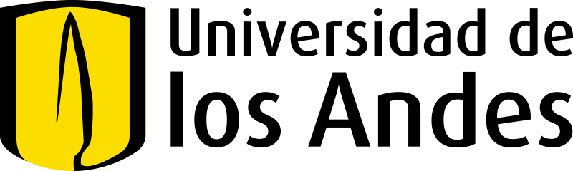
A Multi-Agent System to Repair Breaking Changes Caused by Dependency Updates in Kotlin Multiplatform
Santiago Bobadilla
Febrero 2025 – Bogotá D.C., Colombia
Advisor: Camilo Escobar

Slide 2
01
Context
02
Problem
03
General Objective
04
Specific Objectives
05
State of the Art
06
Bibliography

Slide 3
01
Context

Slide 4
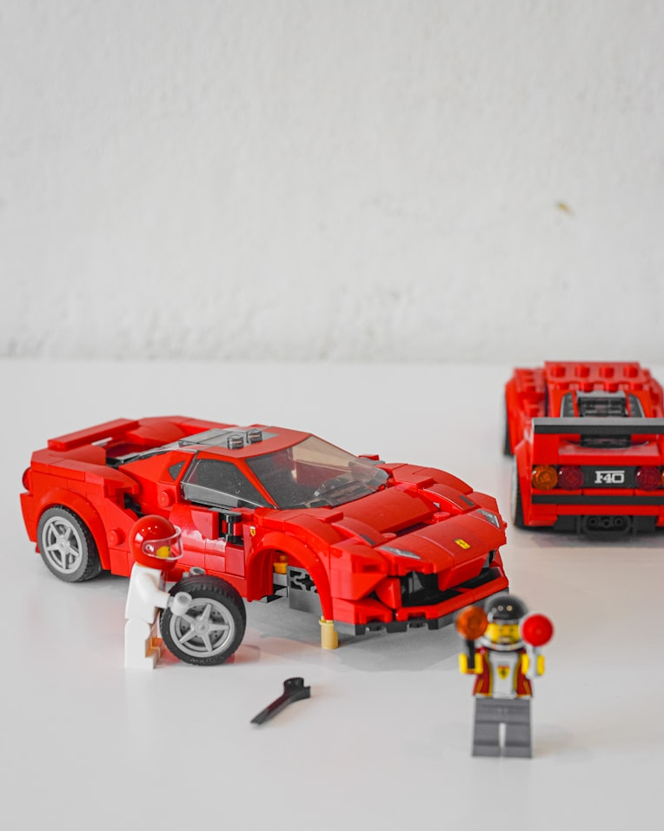
Analogy of Problem
Car Mantainance
Maintaining aging vehicles requires expert diagnostics due to mechanical complexity and wear, often resulting in high costs and unpredictable reliability outcomes.
The scarcity of discontinued components necessitates complex retrofitting or sourcing modern alternatives, which may require structural or mechanical modifications.
Substituting original components with aftermarket or adapted solutions often restores basic functionality at the expense of peak performance and original design intent.
The same applies to code library
and dependency updates.

Slide 5

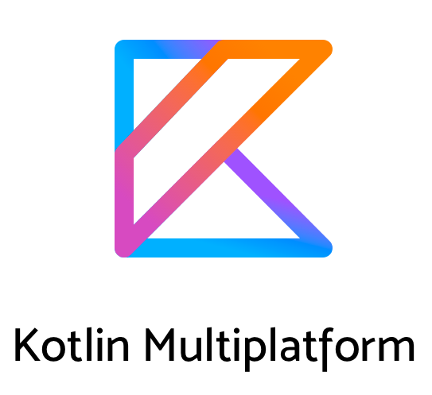
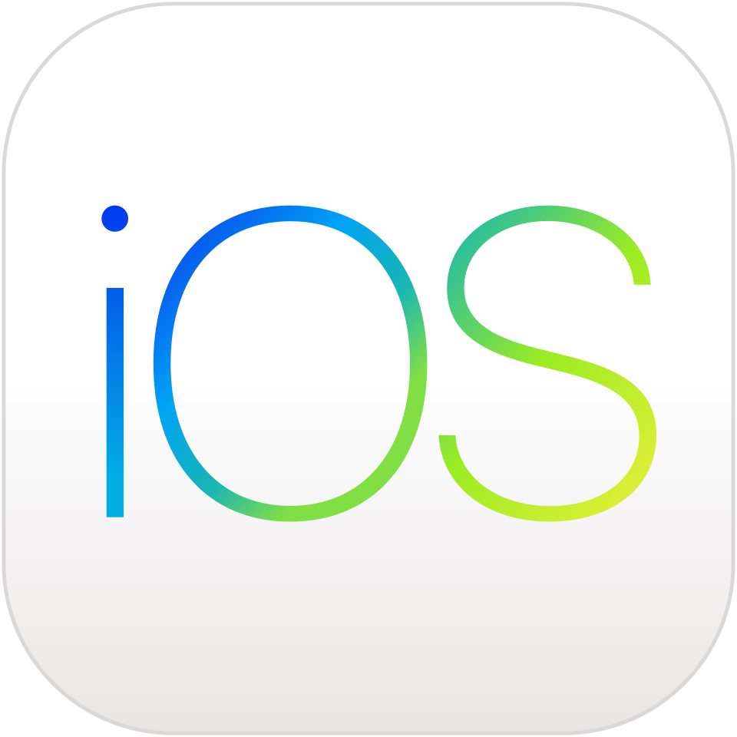
Framework
Kotlin Multiplataforma
Android
iOS
Maintaining native Android libraries involves managing complex versioning and technical debt, where updating deprecated dependencies often risks breaking existing system logic.
Centralize Core Business Logic
Swift development faces similar hurdles with third-party library lifecycle management; sourcing modern alternatives for discontinued components requires significant refactoring to maintain performance.

Slide 6
02
Problem

Slide 7
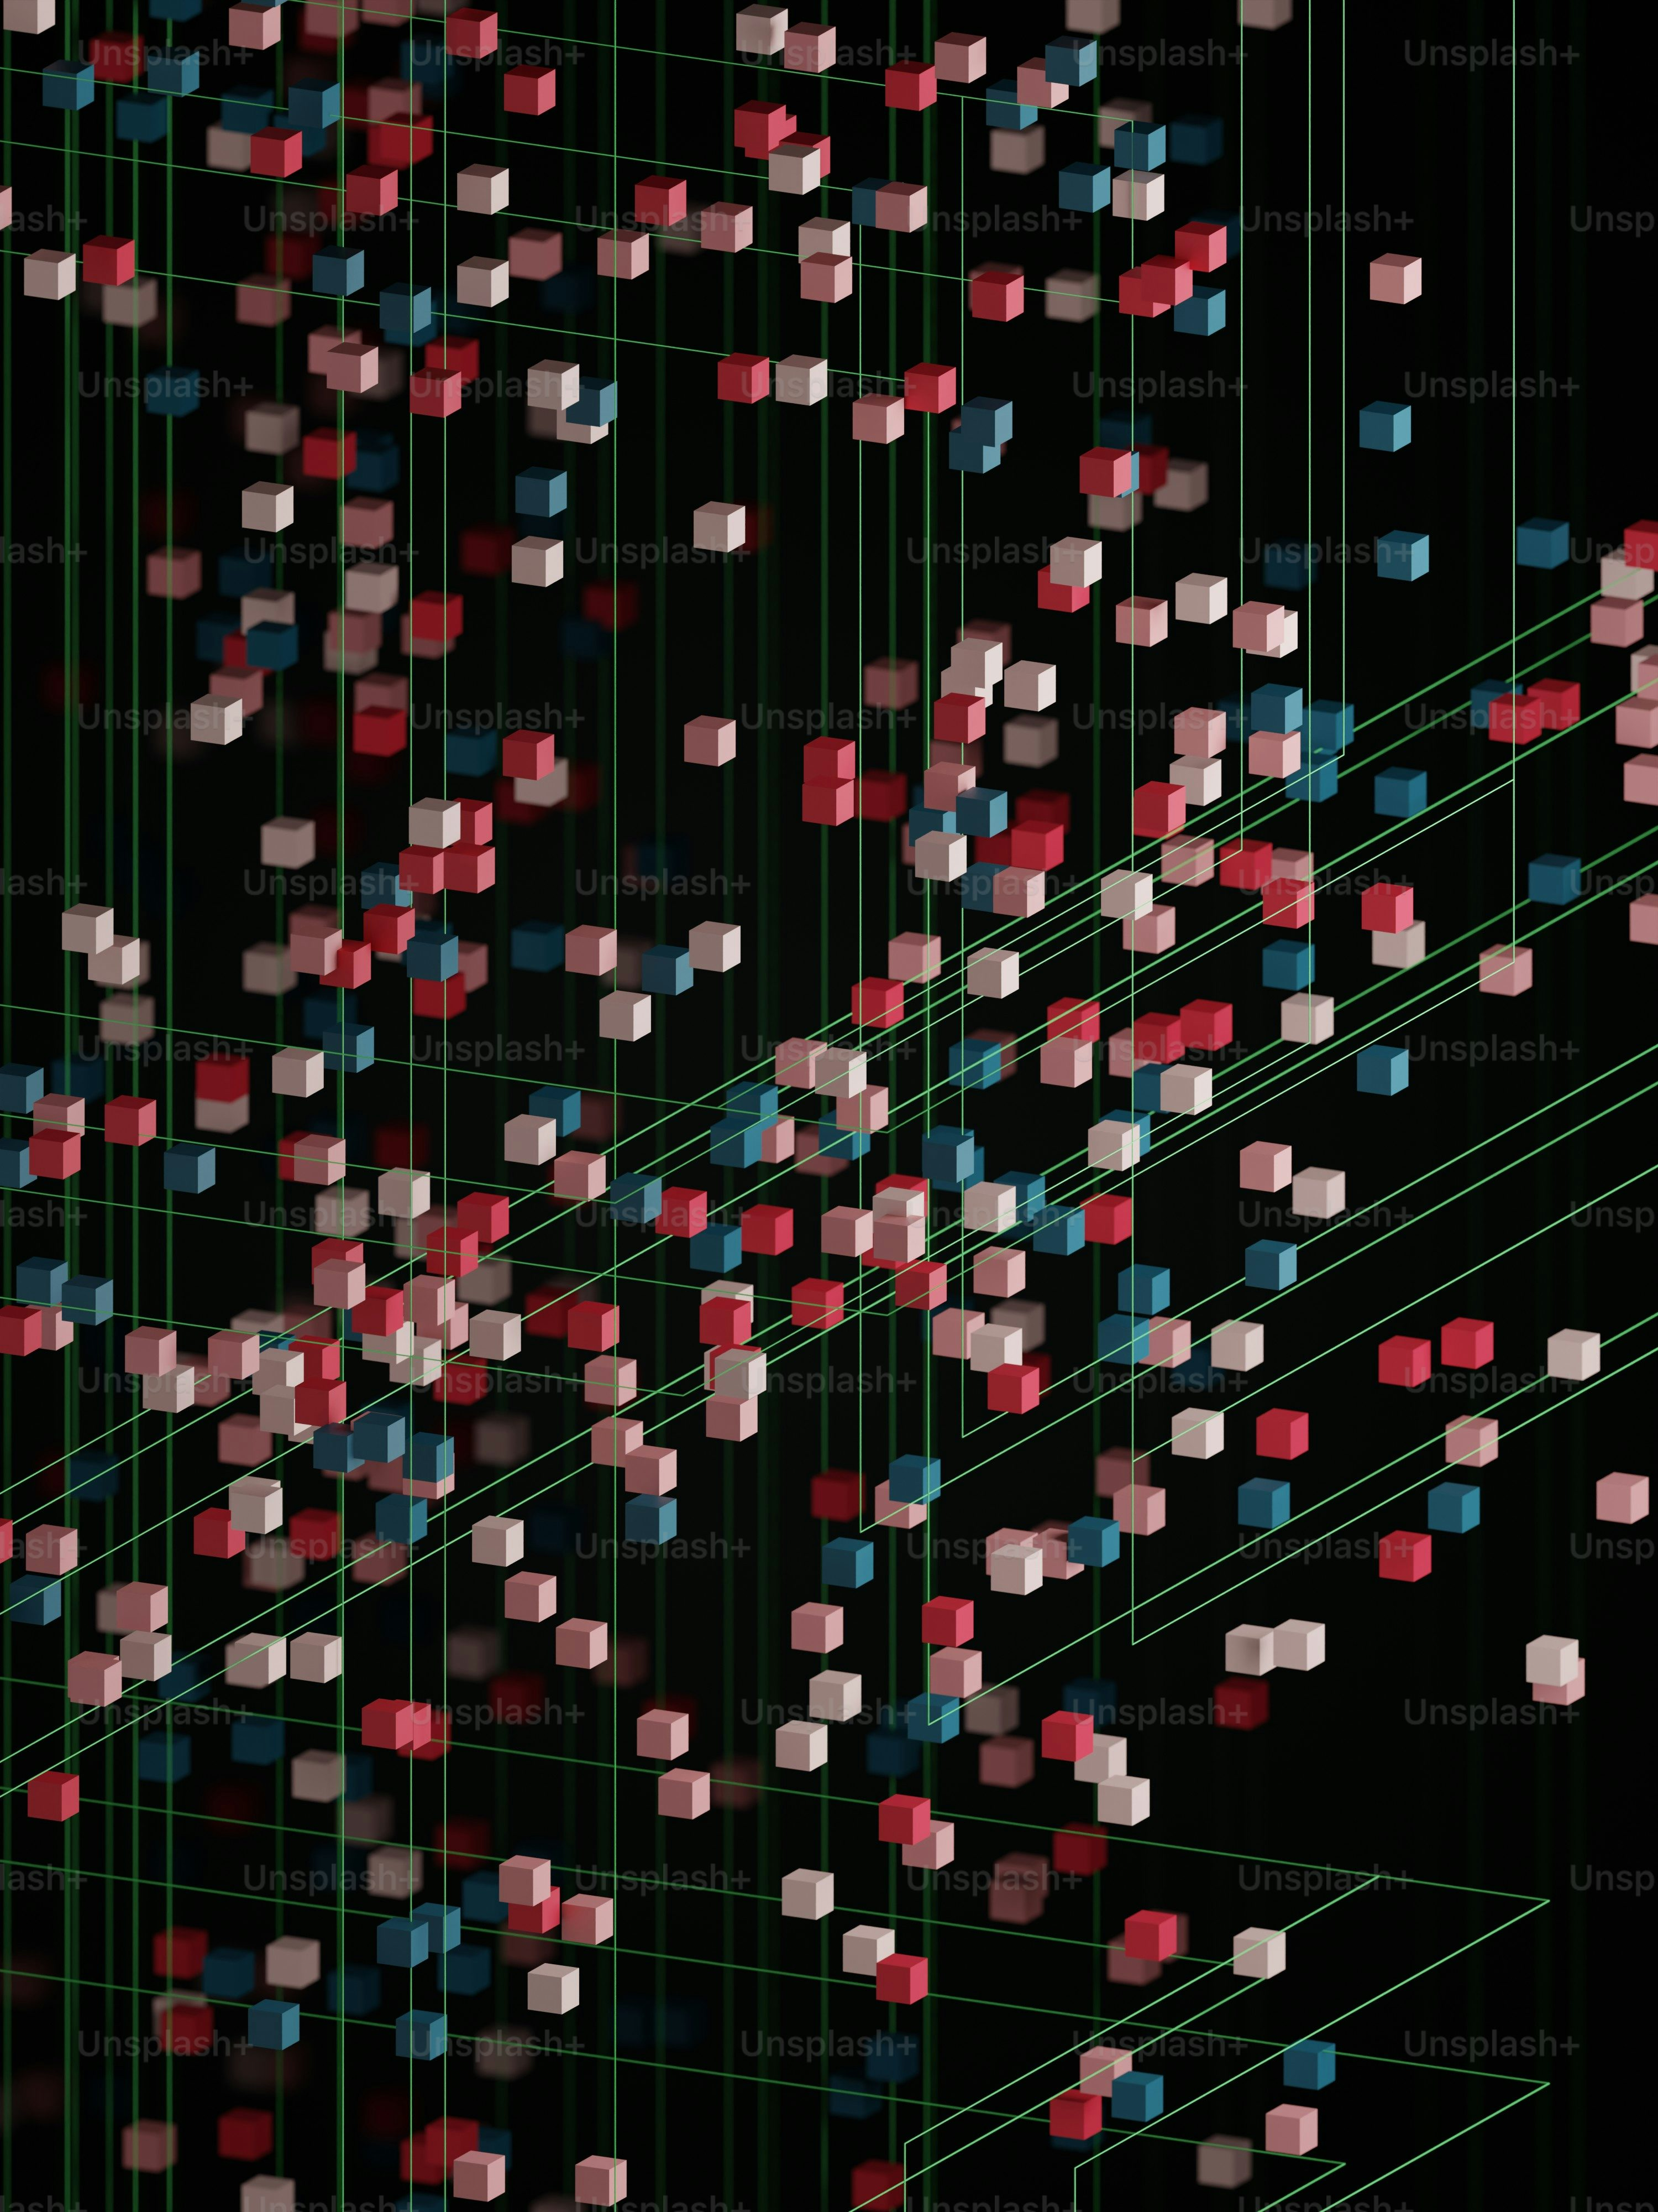
Definition of Problem
Framework
Costs
Tools like Dependabot / Renovate automatically open PRs for security or version updates. [3][4][5]
Updates frequently trigger breaking changes, including compilation errors, modified APIs, broken tests, or runtime bugs.[6][7]
On practice, breaking is common: in Maven, approximately 1 in every 3 releases introduces at least one breaking change.[6]
Falling behind on versions increases security vulnerabilities. [2]
Broken PRs delay patching, increasing system exposure and non-compliance risk. [9]
The core challenge lies in identifying exactly what broke, where the API is utilized (directly or transitively), and executing a correct migration. [7]
Bots rely on CI, but coverage is limited: ~58% for direct dependency calls and ~21% for transitive calls (Java). [10]
El software depende de muchas librerías/SDKs/plugins que cambian constantemente.
Bot PR → CI Red → Stuck PR → Backlog/Noise → Unplanned Work

Slide 8
03 / 04
General Objective / Specific Objectives

Slide 9

Objectives
Orchestration of a multi-agent system to automatically repair breaking changes in Kotlin Multiplatform projects (Android and iOS only) caused by dependency updates, using contextualization based on static and dynamic analysis.
Understand KMP applications by integrating static and dynamic data into a Graph and Code City visualization.**
Map interdependencies and library versions in KMP projects to pinpoint signature discrepancies and assess the impact of breaking changes.
Implement a multi-agent cycle to automatically update and repair libraries one at a time, using cross-platform build validations to generate and refine fixes.
Measuring both compilation success and functional correctness to track improvements in coupling, cohesion, and complexity.
** In collaboration with a undegrade student.

Slide 10
05
State of the Art

Slide 11
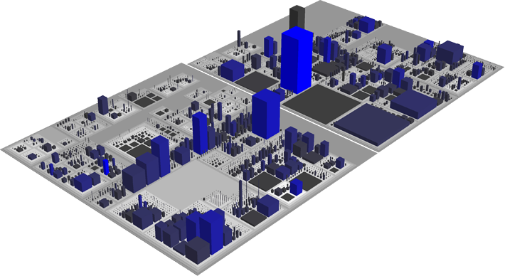
Specific Objectives
Understand KMP applications by integrating static and dynamic data into a Graph and Code City visualization.
State of the Art
Representation of software artifacts as urban elements where classes are buildings and packages are districts. Provision of an immersive experience that avoids the common disorientation found in 3D visualizations [3]
KMP allows sharing logic without compromising native performance or user experience. [1]
ReviewVis: Graph-based visualization is beneficial for increasing the understanding of changes during code review [6]
DroidBot is as easy to use as random tools (Monkey) but with the advanced capabilities of extensible models. The use of dynamic models allows reaching more UI states in less time than random generators. [7]

Slide 12
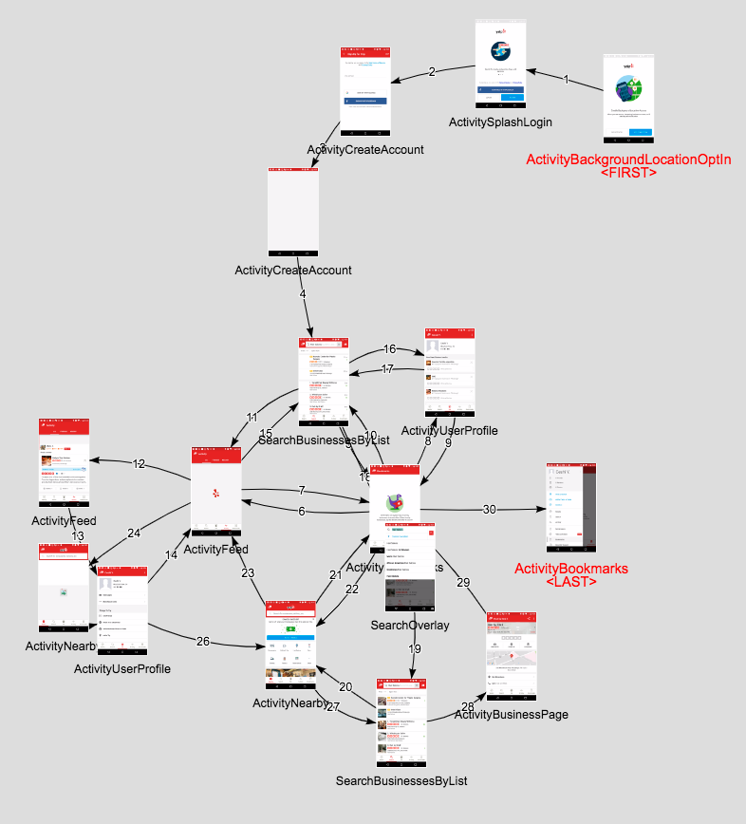
Specific Objectives
2. Map interdependencies and library versions in KMP projects to pinpoint signature discrepancies and assess the impact of breaking changes.
State of the Art
ReviewVis: Graph-based visualization is beneficial for increasing the understanding of changes during code review [6]
The inclusion of Python dependencies with RelationGraph improves the resolution rate from 31% to 52.33% compared to non-graph models. Precise identification of errors at the class level (76.4%), function level (56.7%), and line level (40.7%). [1]
Define pipeline that extracts error information, queries APIDiff, and generates patches using LLMs significantly improves the partial repair capability in Java. [4]
In Java, 11.58% of dependency updates contain breaking changes (BCs) that impact the client. Changes in transitive dependencies are the primary cause of BCs in clients (20.36% of manually analyzed cases). 41.58% of detected BCs occur in non-major updates (Minor or Patch). [2]
There is no study for Kotlin Multiplatform.

Slide 13
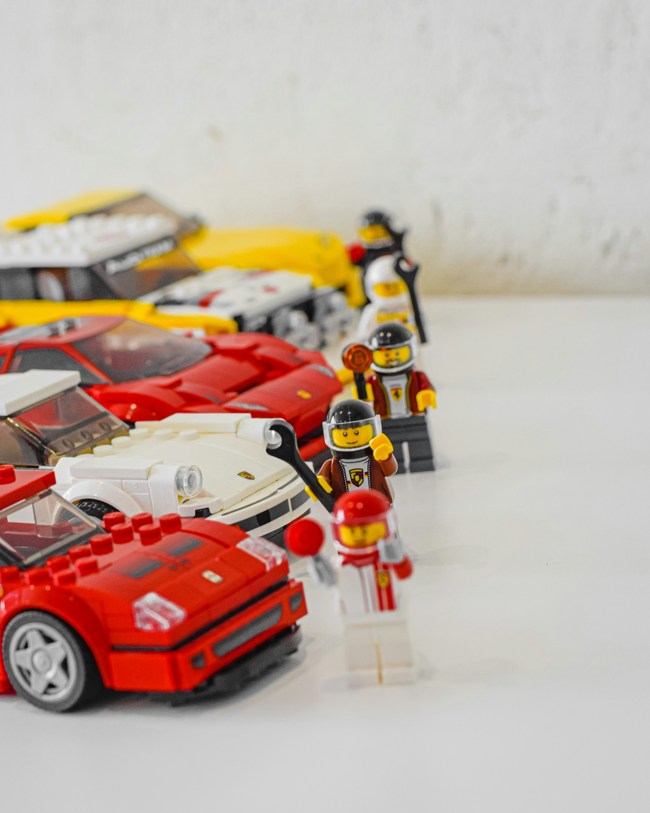
Specific Objectives
3. Implement a multi-agent cycle to automatically update and repair libraries one at a time, using cross-platform build validations to generate and refine fixes.
State of the Art
Agentic systems (such as MAGIS or SWE-Agent) allow for handling errors across multiple files and at the repository level. The integration of static analysis diagnostics (AAG) improves the success rate and the validity of patches. [1]
LADU (Java): Drastic reduction in steps (18 compared to 106 from the competition) and significantly lower token consumption due to Meta-RAG condensation. [2]
The intrinsic capability of the model (especially reasoning models) is more critical than the prompt design alone. [3]
There is a strong correlation r = 0.702 between the model's ability to manipulate the Java AST and its success in repairs. [4]
Define the agent's MCP structure to interact with the contextualization of the KMP APP.

Slide 14
Specific Objectives
4. Measuring both compilation success and functional correctness to track improvements in coupling, cohesion, and complexity.
State of the Art

Slide 15
06
Bibliography

Slide 16
Bibliography
Problem
[2] | https://ceur-ws.org/Vol-3941/BENEVOL2024_TECH_paper15.pdf
[3] | https://sailresearch.github.io/sail-website/data/pdfs/2022_Understanding_the_Customization_of_Dependency_Bots.pdf
[4] | https://www.blackduck.com/content/dam/black-duck/en-us/whitepapers/wp-managing-transitive-dependencies-in-oss.pdf
[5] | https://jstvssr.github.io/assets/pdf/semantic-versioning-maven.pdf
[6] | https://martinfowler.com/articles/continuousIntegration.html
[7] | https://nvlpubs.nist.gov/nistpubs/SpecialPublications/NIST.SP.800-204D.pdf
[9] | https://docs.github.com/en/code-security/tutorials/secure-your-dependencies/dependabot-quickstart-guide
[10] | https://docs.renovatebot.com/key-concepts/automerge
Objective 1
[1] | https://eajournals.org/ejcsit/vol13-issue-44-2025/architecting-shared-logic-with-kotlin-multiplatform-mobile-benefits-challenges-and-ecosystem-positioning/
[3] | https://www.sciencedirect.com/science/article/pii/S0167404825003463?via%3Dihub
[6] | https://www.sciencedirect.com/science/article/pii/S0164121222001820?via%3Dihub
[7] | https://ieeexplore.ieee.org/document/7965248/
Objective 2
[1] | https://aclanthology.org/2025.findings-acl.252/
[2] | https://dl.acm.org/doi/10.1145/3597926.3598147
[4] | https://arxiv.org/abs/2505.07522
[6] | https://ieeexplore.ieee.org/document/10174082
Oobjective 3
[1] | https://arxiv.org/abs/2506.23749
[2] | https://arxiv.org/abs/2510.03480
[3] | https://arxiv.org/abs/2505.07522
[4] | https://dl.acm.org/doi/10.1145/3729366

